Slide 1
Fraud_Guard: Real-Time Financial Fraud Detection
PRESENTED BY: RADHESHYAM CHAURASIYA
DATE: 2026/01/30

Slide 2
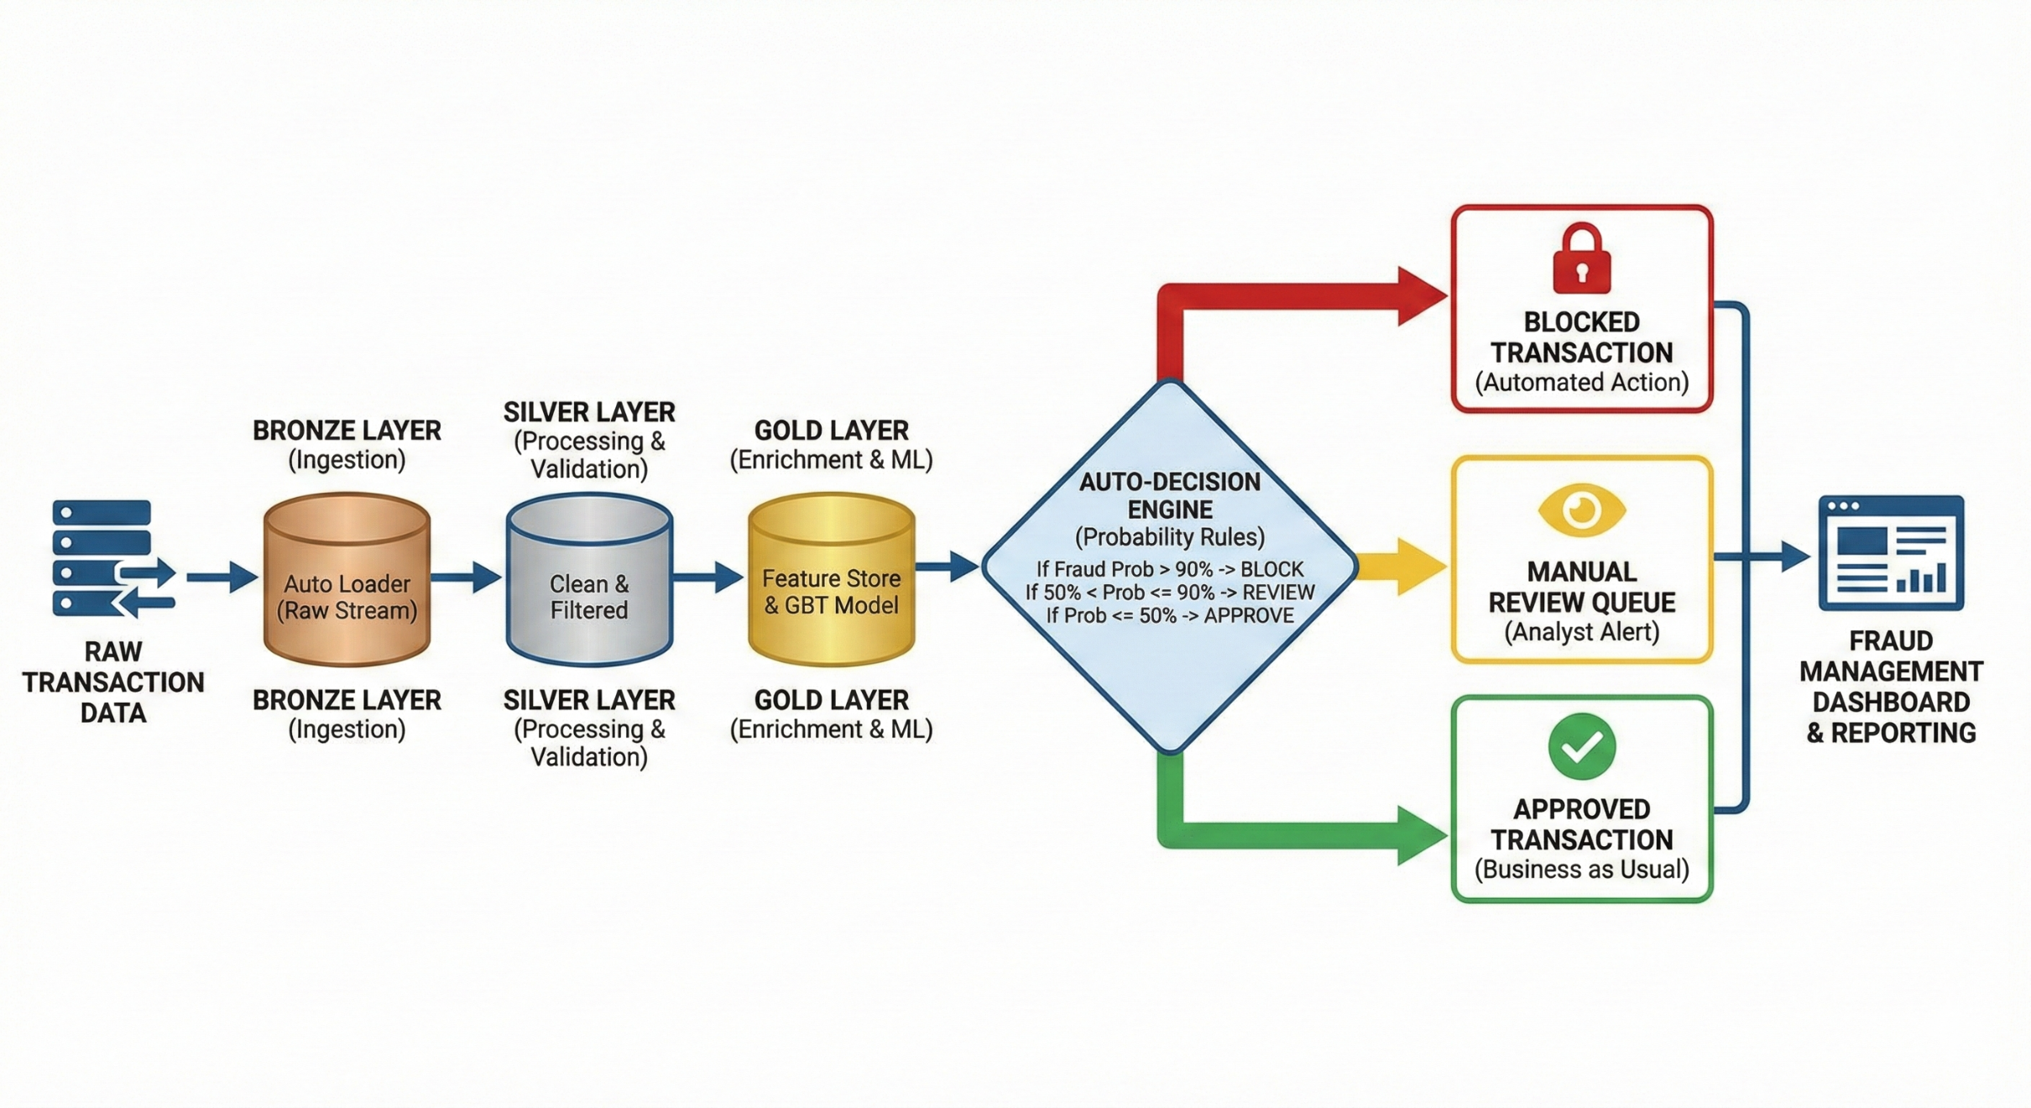
PROJECT OBJECTIVES
Primary Goal:
Develop an automated AI system that detects fraudulent credit card transactions in real time.
Scoring Mechanism
Generate a Fraud Probability score (0 to 1) for every transactions.
Automation
Build a “Medallion Architecture” pipeline (Bronze Silver Gold) that process data without human intervention.

Slide 3
Data Understanding
Dataset Overview:
Source : 1.3 Million Transaction Records from Kaggle.
Key Raw Variables (Input):
Columns | Importance
trans_date_trans_time | Timestamp of transactions
amt | Transactions amount in USD
Categeroy | Type of expense (grocery, gas, travel)
dob | Birth date of merchant
merch_lat / merch_long | Location of the merchant
lat / long | Location of customer

Slide 4
Features Creation (The “Gold Layer”)
Derived Feature | Logic/ Formula | Business Risk Insight
distance_km | Haversine Formula: calculate distance between lat/long(user) and merch_lat/merch_long(Store). | If a user swipes their card 500km away from home within 10 minute, It a high risk.
amt_relative_to_category | Window Function: Amount/ Avg ( Amount) partitioned by User and Category. | A $500 charge is normal for Travel but suspicious if the user usually spends $20 on Groceries.
hours_of_day | Time Extraction: Extracted hour (0-23) from timestamp. | Fraud spikes between 1 AM – 3 AM (as confirmed by EDA).
day_of_week | Day Extraction: Extracted day form timestamp. | Help to capture weekend fraud pattern

Slide 5
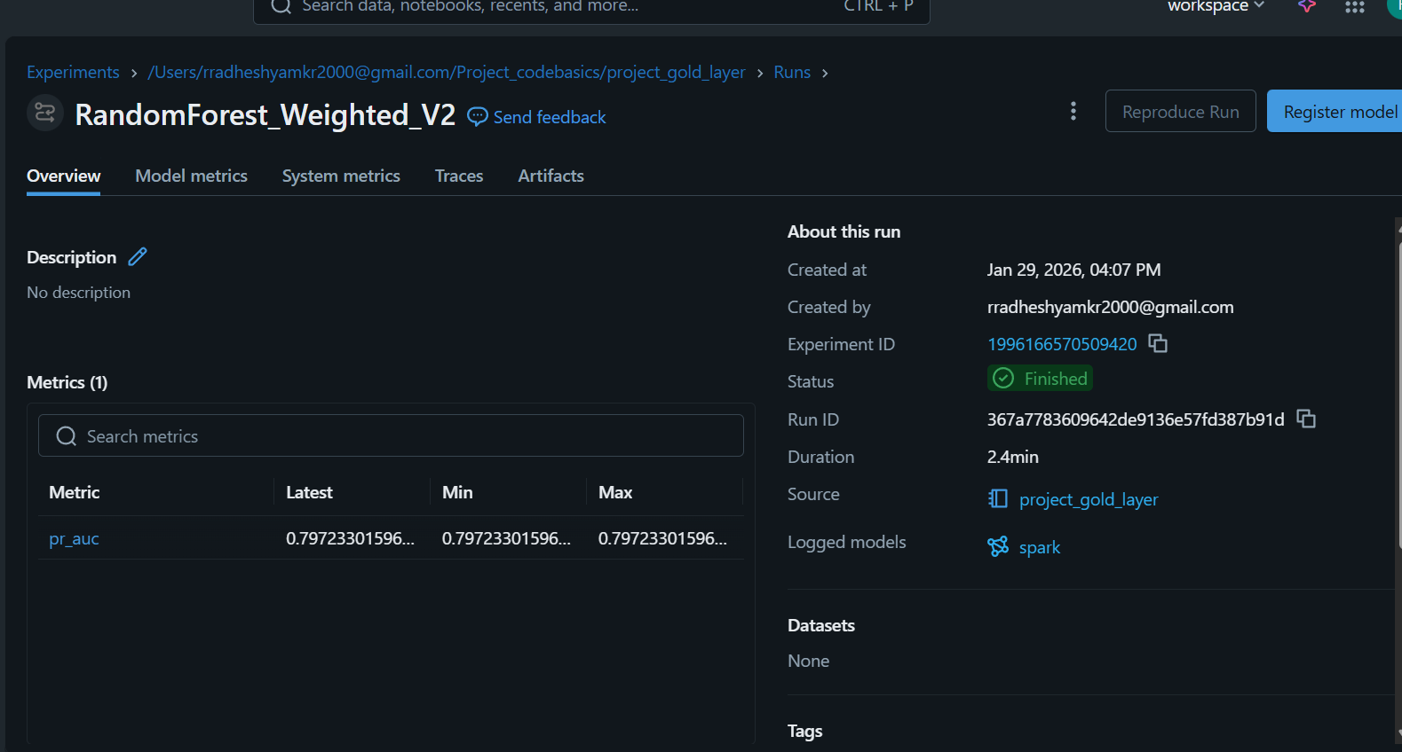
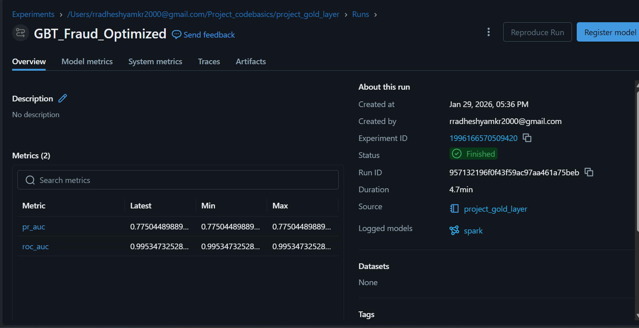
Model Training Strategy
Attempt 1: Random Forest (Weighted)
Approach : Standard Random Forest model with balanced class weights.
Result : High Accuracy (99%) but Low Recall (0.79 PR AUC). It failed to capture the minority fraud class effectively.
Attempt 2: Gradient Boosted Trees (Weighted)
Approach : Iterative GBT Classifier with aggressive 100x Class Weighting to punish missed fraud.
Result: Production-Ready (0.77 PR AUC) with 0.99 ROC AUC. Effectively identified rare fraud cases without excessive false alarms .
GBT aggressively "corrected" the errors on the difficult fraud cases that RF missed.

Slide 6
Final Evaluation Metrics
The GBT Model was selected.
Metric | Value | Interpretation
ROC AUC | 0.9953 | The model is nearly perfect at telling the difference between a Thief and a Legitimate Customer.
PR AUC | 0.7750 | Even though fraud is very rare the model finds it consistently without guessing.
Precision | 0.9952 | When our model flags a transaction as fraud, it is 99.5% likely to be correct.
Recall | 0.9781 | The system successfully catches 97.8% of all actual fraud attempts.
F1 Score | 0.9852 | This proves the model is not just guessing. It has achieved a perfect balance between catching thieves (Recall) and protecting good customers (Precision).
Accuracy | 0.9781 | Across all transactions (both fraud and normal), the model makes the correct decision 97.8% of the time.

Slide 7
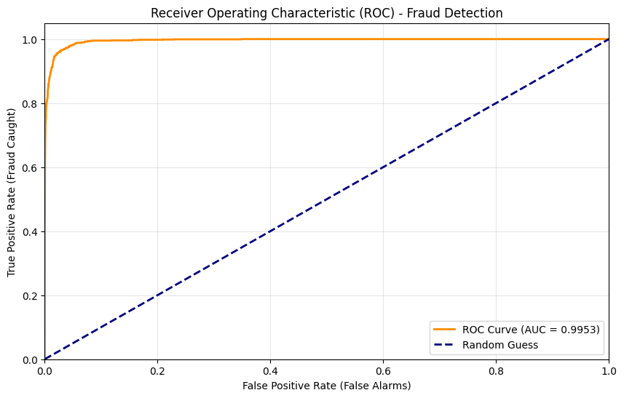
Success Criteria
Precision-Recall AUC > 75%:
Why: Since fraud is rare (0.5%), standard Accuracy is misleading. The model must maximize the detection of actual fraud (Recall) while minimizing false alarms(Precision).
ROC AUC > 95%:
The model must effectively discriminate between a Thief and a Legitimate Customer.
Business Explainability:
The model must output Feature importance to explain why a transaction was blocked (for e.g : user is to far from merchant).

Slide 8
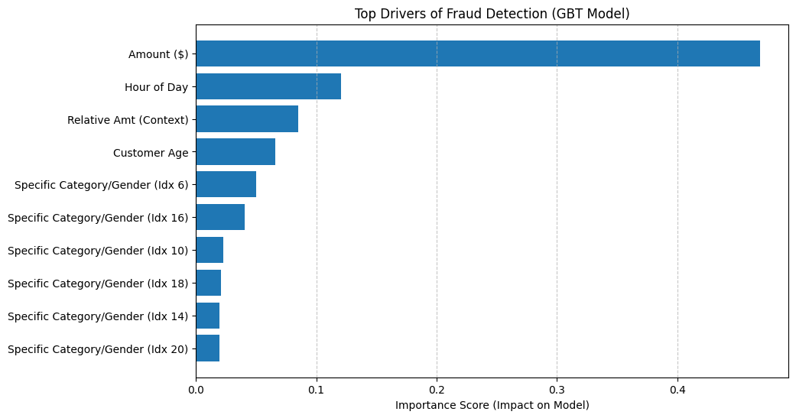
Feature Importance

Slide 9
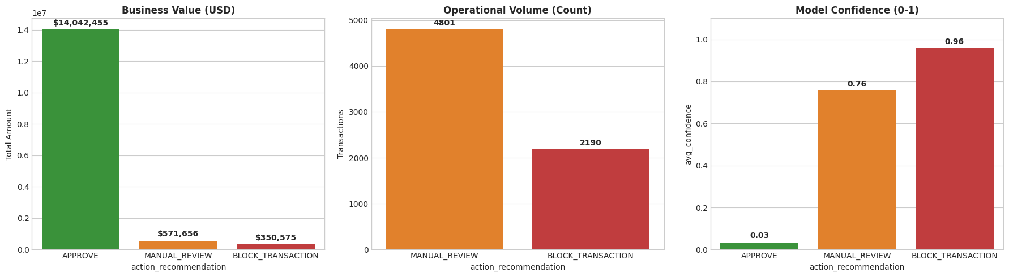
Business Dashboard
Automated Action Plan:
BLOCK : Probability >90%
REVIEW : Probability 50% - 90%
APPROVE : Probability <50%

